Slide 1

PROJECT TITLE:
Smart Medicine Reminder For Elderly People
IRENE CRESENCIA
JEMIMAH RINSY

Slide 2
OBJECTIVE
Our project’s main aim is to make a Smart medicine box for those elderly users who regularly take medicines and the prescription of their medicine is very long as it is hard to remember to patients and also for their care giver. Also old age patients suffer from problems where they forget to take pills at the proper time which causes certain health issues for patients having Permanent diseases like diabetes, blood pressure, breathing problem, heart problems, cancer diseases etc.

Slide 3
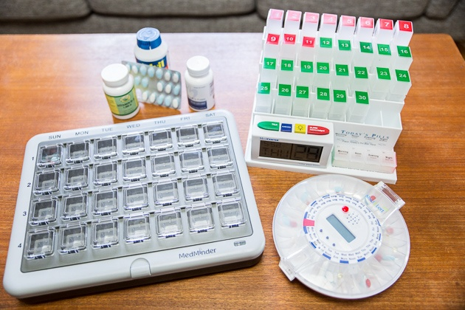
EXISITNG MODEL:
This pill dispenser looks like a basic seven-day pillbox. Its simple and user friendly, the interface has no digital readouts or buttons. It contains 28 compartments and can accommodate dozens of different types of pills.
Patient reminders: When it’s time to take a medication, the appropriate compartment flashes. If the cup is not removed within the assigned time frame, the patient can get auditory prompts as well as optional automatic phone calls, text messages and emails.
Remote monitoring capabilities: MedMinder keeps records of patient activities. The caregiver can access this information via the Internet or receive real-time email or text message notifications. Weekly email reports are also available.

Slide 4
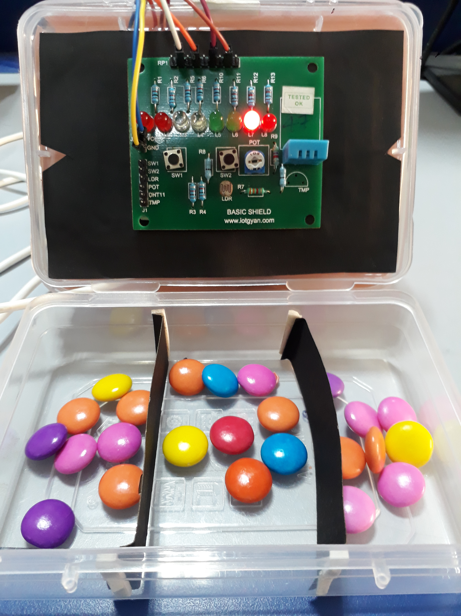
PROPOSED MODEL
We have made a similar model of the previously viewed smart Medicine Reminder.

Slide 5
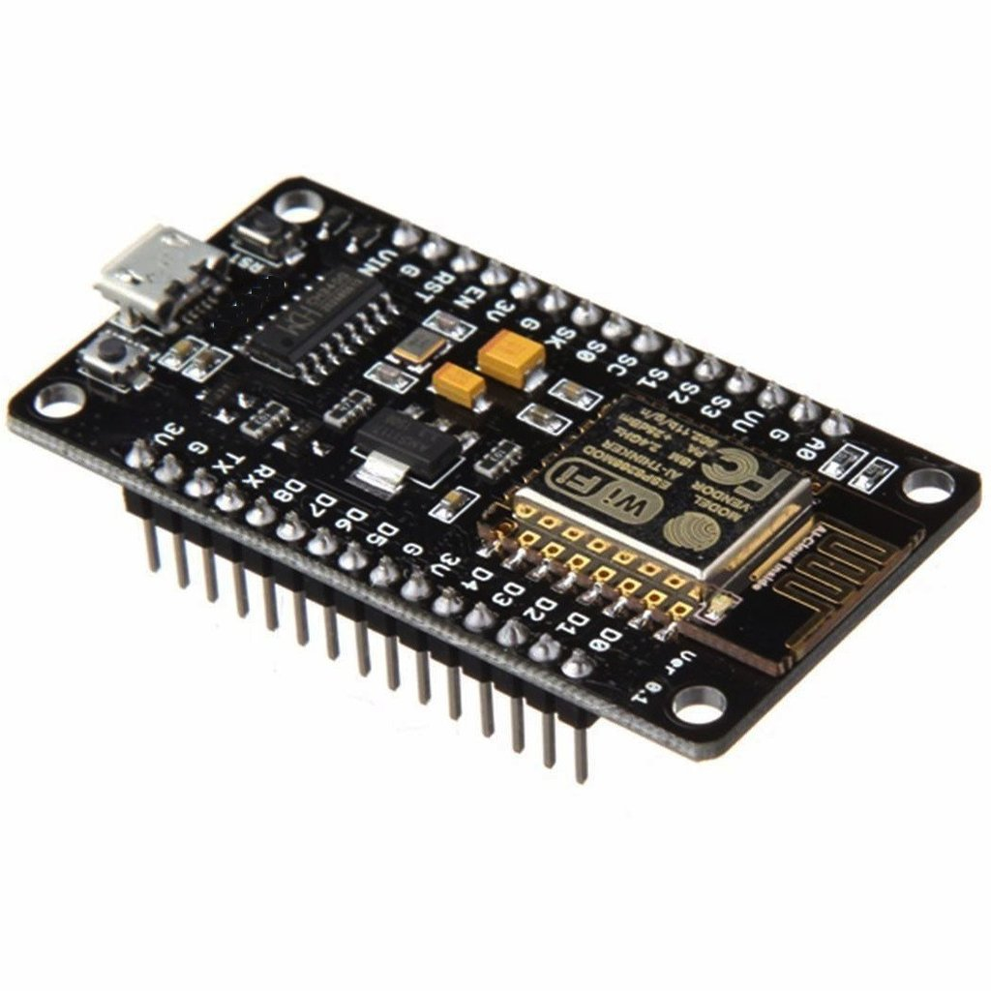
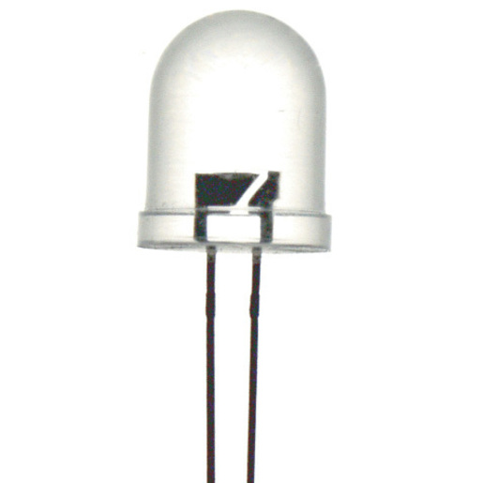
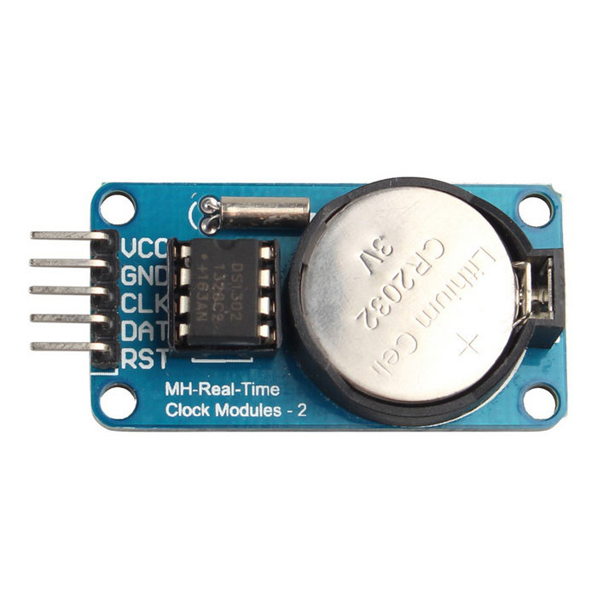
HARDWARE:
ESP8266 Board
LED's
RTC Module
Connecting Wires

Slide 6



SOFTWARE
Arduino IDE
Node-RED
MIT App Inventor

Slide 7



THE SMART MEDICINE HAS THREE SLOTS, EACH SLOT INDICATING THE MEDICINES TO BE TAKEN FOR
MORNING AFTERNOON NIGHT

Slide 8
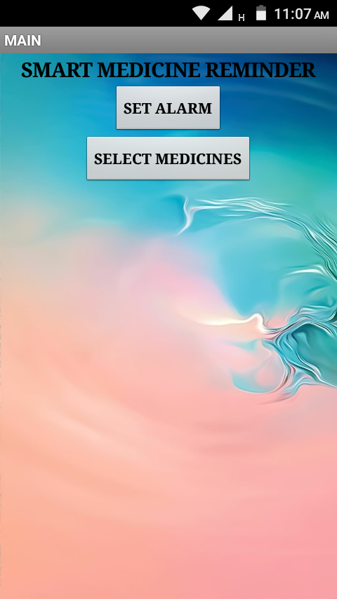
The project begins by setting the time in the app created by MIT App Inventor.
On pressing the first button “SET ALARM”, the user is taken to a new screen that enables them to set the specific alarms.
On pressing the second button “SELECT MEDICINES”, the user is navigated to a web page, with which the user can make an online shopping of the medicines.

Slide 9
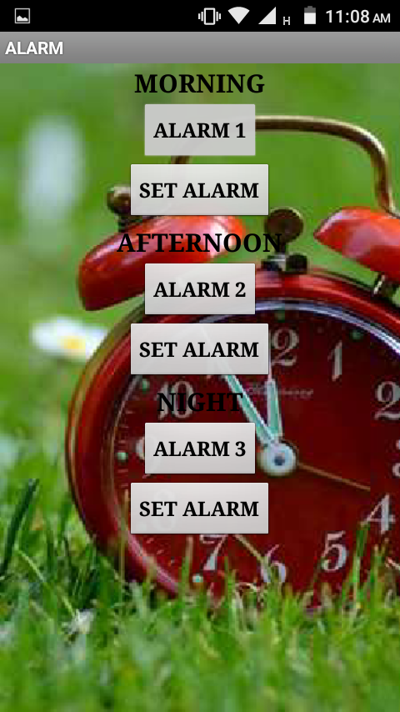
This is the screen which enables the user to set the timings for the alarm.
Alarm 1, Alarm 2, Alarm 3 is a timepicker that helps the user to select time.
On clicking the button “Set Alarm”, the alarm is set and send to the NodeMcu.

Slide 10
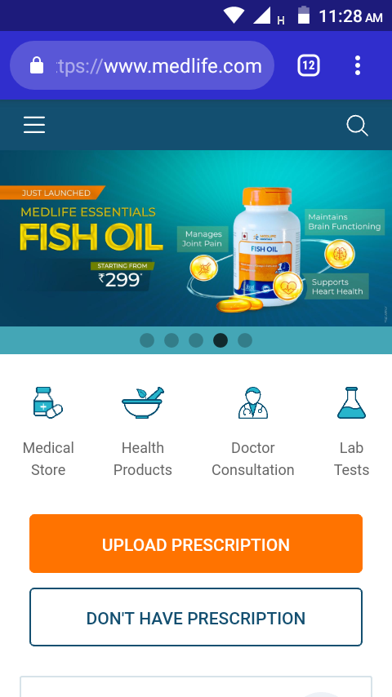
On clicking BUTTON 2, the user is directed to a online pharmacy website, where the user can make the purchase of the necessary medicines on just a click of the button.

Slide 11
The RTC keeps ticking as the module is given the power supply.
When the alarm time matches with the real time, the buzzer blows and the LED corresponding to the time of the day glows with an interval of 1 second.
In the same way, the alarms for afternoon and night also rings along with the glowing of the LED, indicating the user that it's time for medicine.

Slide 12
ADVANTAGES:
Cost Efficient
Needs no prior technical knowledge
Easy to maintain.
Provide comfort and health.
Reusable

Slide 13
FUTURE SCOPE:
Incoporation of an alert call button, which when pressed by the user makes an alert call/text to the care giver notifying that the patient is in need of help.
A button which has to be pressed by the user within the interval of time set, indicating the device that the reminder has been recieved and the medicine is consumed.
Failure to press the button within the time limits, promts the device to send a text notification to the user as well as the caregiver.

